Slide 1
Background
* In a previous meeting the ACME Corp employee named Robert Loblaw with the job title "IT Manager", met with F5 employee Robin Mordasiewicz with a job title "Sales Engineer" who specializes in presenting and selling the F5 Distributed Cloud product. In the previous meeting Robert, who is responsible for maintaining the ACME Corp website https://www.acmecorp.com, explained to Robin that a security audit of the ACME Corp website revealed that there is currently an ongoing credential stuffing attack, which is leading to signifiant revenue loss and reputation damages.
* Robert also explained to Robin that the current architecture of the ACME Corp website is using the Akamai Content Delivery Network (CDN), with the additional subscription of the Akamai Web Application Firewall (WAF) product named Kona. Robert has learned that the Akamai Kona product does not protect against credential stuffing attacks, and that in order for Akamai to prevent credential stuffing attacks, Robert would need to purchase an additional Akamai product subscription named Akamai Bot Manager. Furthermore, Robert explained that the Akamai CDN load balances to origin servers that are hosted in AWS, and the origin servers that are in AWS which are hosting the website content are also connected to an on premisis datacenter using DirectConnect for database access, and that future plans to be considered are that the ACME Corp website will also expand to be running in both AWS and Azure.
* Robert has invited Robin to present a competetive Bot Protection product from F5 Distributed Cloud in the hopes that the F5 Distributed Cloud product is more fully featured and easier to use. Robert asked Robin to present the F5 Distributed Cloud Bot Protection functionality as well as the additional value add features that the F5 Distributed Cloud product can help with modernizing the ACME Corp website, specifically around multi-cloud networking.
* What follows is the content for an F5 Distributed Cloud presentation focusing on credential stuffing attacks, that Robin will present to Robert.

Slide 2

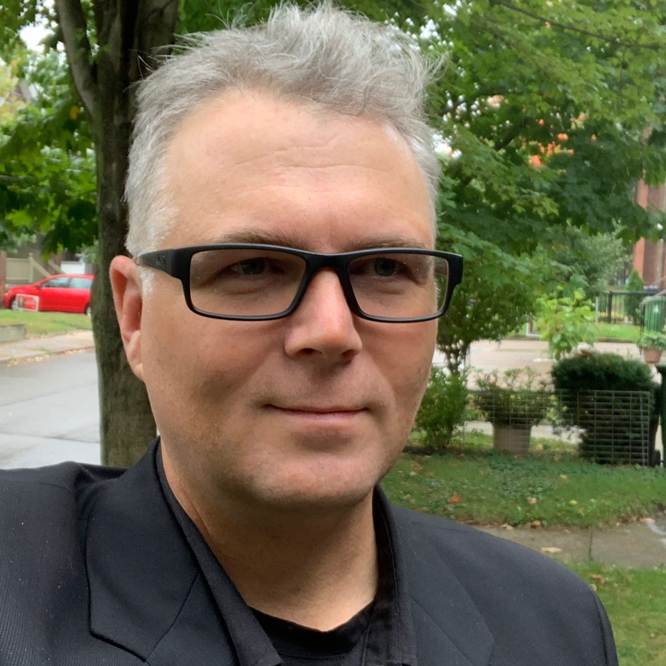
F5 Distributed Cloud
Robin Mordasiewicz – Sales Engineer

Slide 3
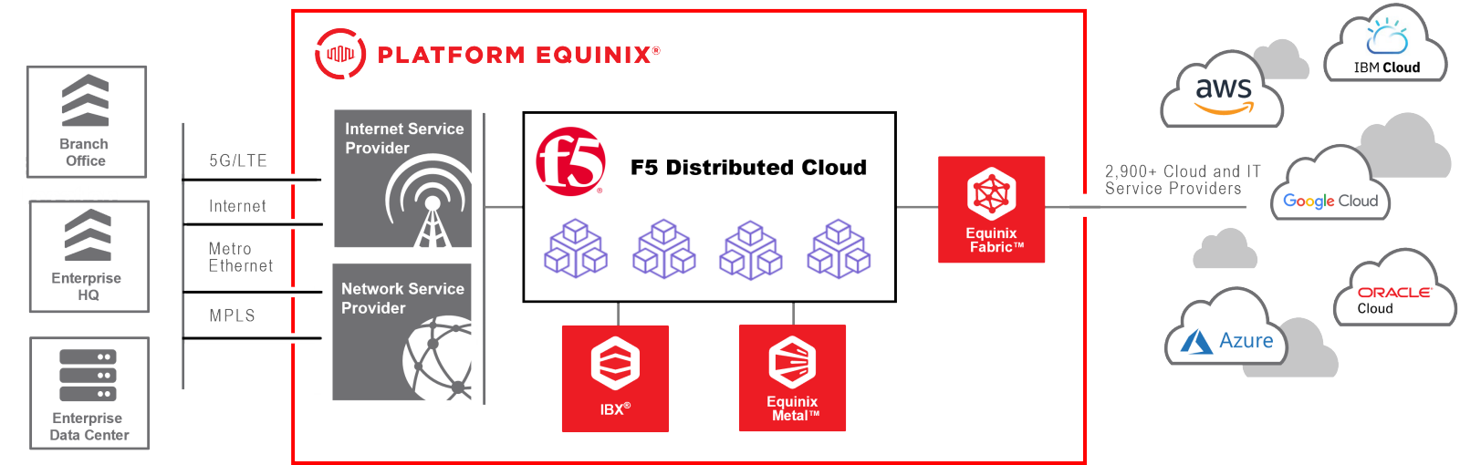

Slide 4

Locations
BGP Peers
Shape
Locations
BGP Peers
Linode
Bot Manager
Kona

Slide 5
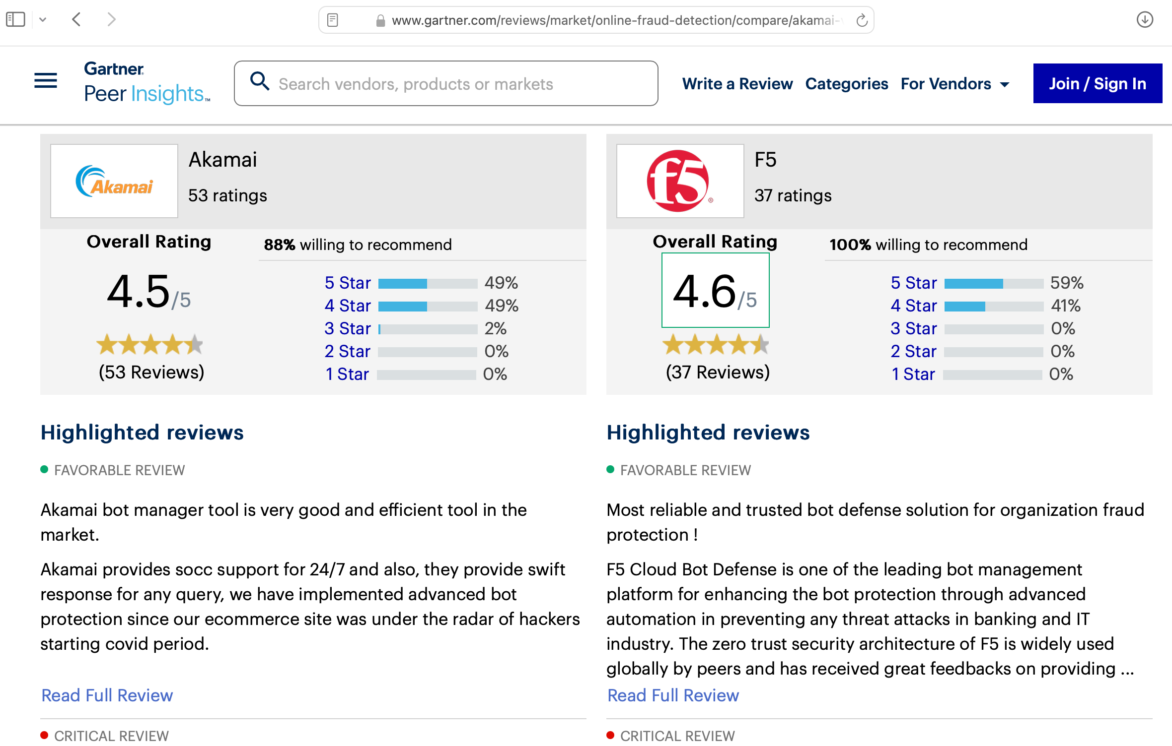
Gartner Peer Report
Notes:
F5 Distributed Cloud Bot Defense scores higher in Gartner Peer reviews, mostly becuase of the ease of use, since all of the UI and API management is a single consolidated interface.

Slide 6
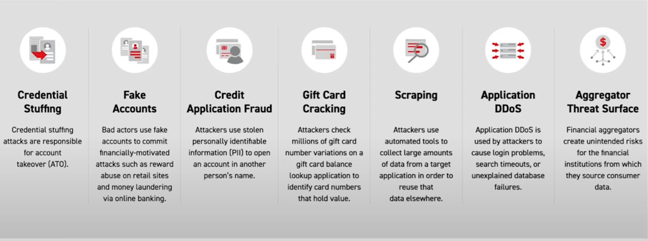
Bot Protection
Notes:
The F5 solution that I want to highlight today is the F5 Distributed Cloud Bot Protection specifically to address your ongoing credential stuffing attack.
Credential stuffing abuses login forms to gain unauthorized access to customer accounts. These attacks typically leverage automated tools and compromised credentials, but often evolve to imitate human behavior or impersonate real customers, and the Bot Protection portfolio not only addresses credential stuffing, but credential stuffing is often the precursor to account takeover, fraud and other attacks.

Slide 7
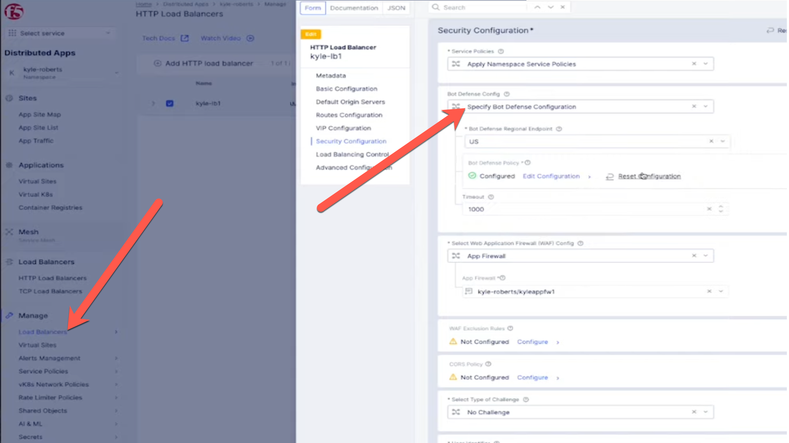
Enable Bot Defense

Slide 8
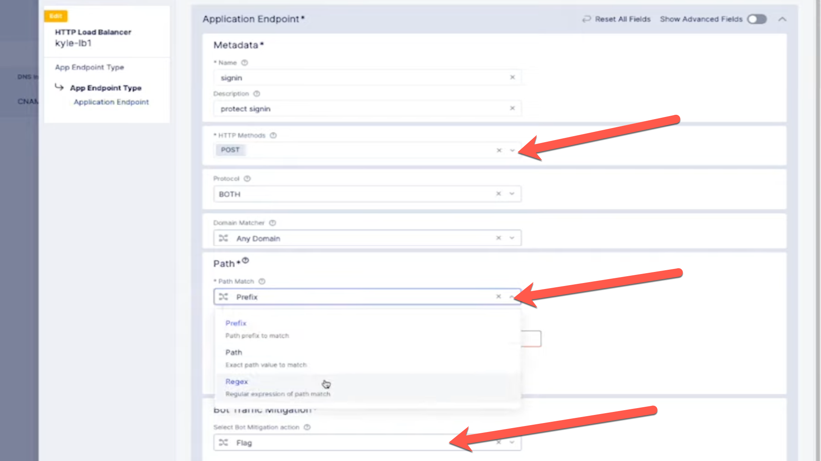
Create Bot Policy
Notes:
Create an app endpoint
Specify the method to POST on both protocolm on any domains, and for Path matching we can do prefix, regex or exact path, and for the actions you want to change it from Flag to Block.
There can enable carding against a payment page and credential stuffing against other pages.
From there we can specify how we want to inject the Javascript, which usually after the HEAD tag, but it can be in a script or after the title tag.

Slide 9
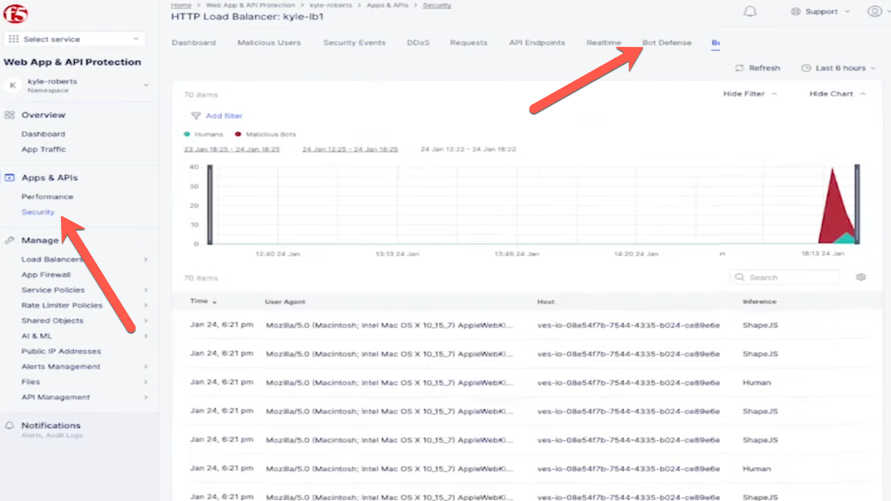
Bot Defense Reporting
Notes:
After launching an attack using a tool such as Selenium.
Launch the security dashboard where you will find all the analytics for your applications.
The ashvboard will show which endpoints are attacked the most, or which automations types are being used
You can customize the time period and filter for specifc attacks, and get detailed insight into

Slide 10
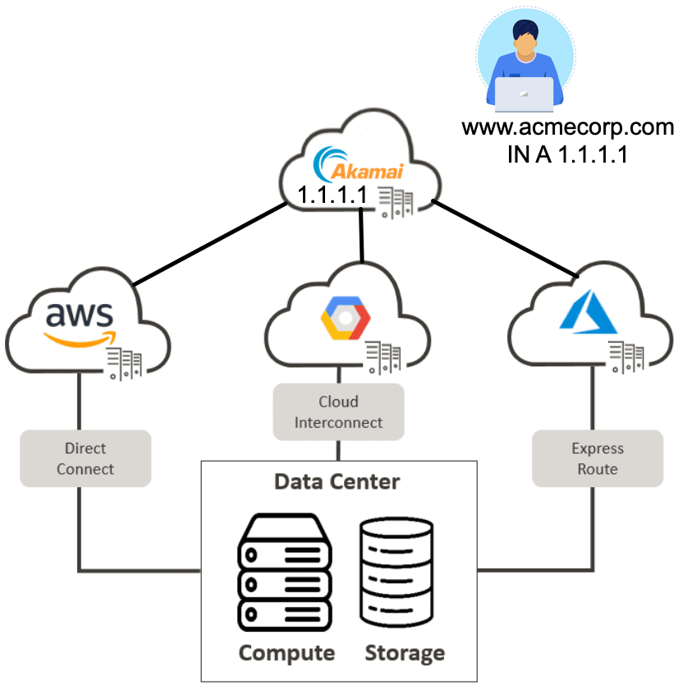
Deployment Options
Notes:
* Currently the ACME Corp website is using Akamai, which then load-balances to origin servers that are running in a VPC. AWS VPC’s use DirectConnect so that the origin servers can to consume the database services running on prem.
* When implementing a significant change there needs to be care taken into consideration when planning out an implementation. Currently the ACME Corp website has a static DNS record which resolves to an Akamai anycast IP address. The challenge is, "How is it possible to introduce F5 Distributed Cloud without making any disruptive changes that might cause downtime".

Slide 11
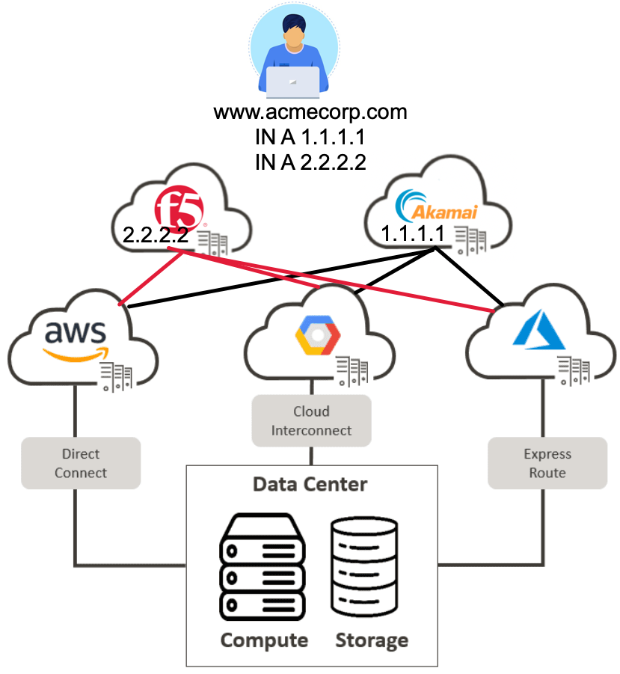
Multi CDN
Notes:
The answer is to use an intelligent DNS service which provides GSLB load balancing balancing so that we can safely introduce an additional A record into the DNS. By leveraging GSLB functionality into the DNS for the ACME Corp website, it will make it possible to use multiple CDN services. Different GSLB algorithms can be configured to provide active-standby, geographically based DNS resolving decisions, or making DNS resolver decisions based on health checks, which might detect outages or problems with a primary CDN. Introducing GSLB to the internet facing DNS resolution for ACME Corp website will make it so that both the Akamai CDN and the F5 Distributed Cloud CDN are possible.

Slide 12
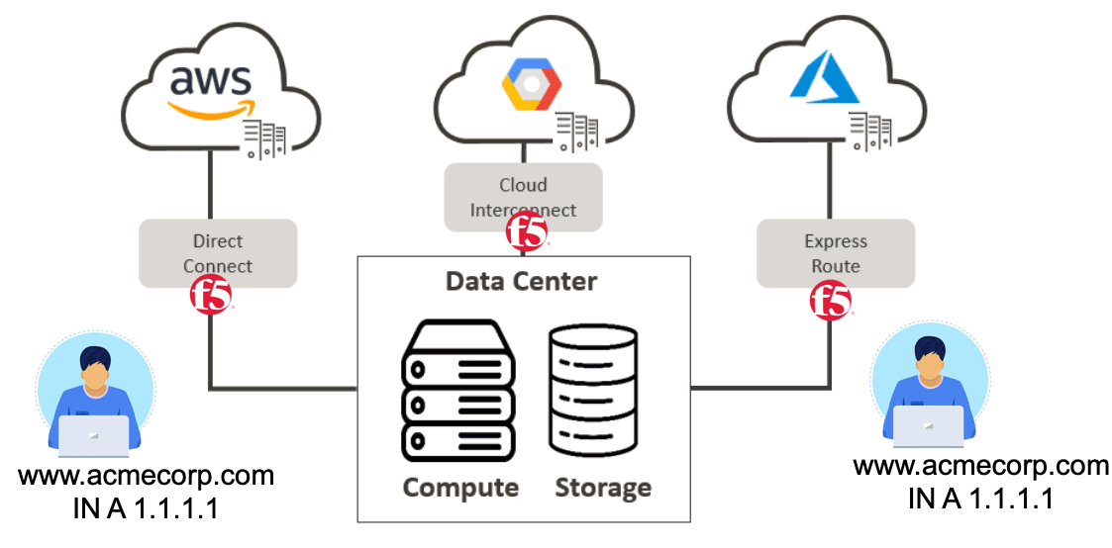
Campus Area Private Networking
Notes:
A unique feature of the F5 Distributed Cloud platform which is not available from Akamai, is that the F5 Distributed Cloud Regional Edges can be configured to advertise services on the same private Network As a Service providers. This means that the F5 Distributed Cloud IP anycast services that are available on the internet, are also the exact same services that can be advertised to internal only campus area type of networks.

Slide 13
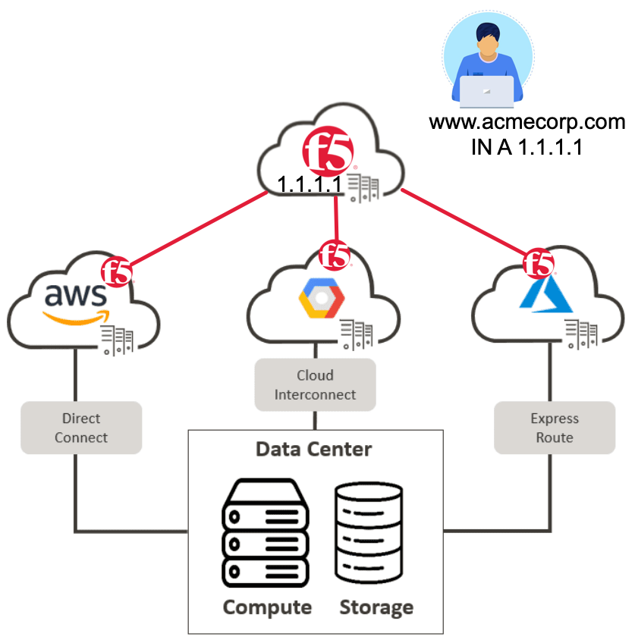
AppStack in VPC
Notes:
The F5 Distributed Cloud software that runs in the Equinex Regional Edge locations, can be deployed as a virtual machine into your VPC's, which can eliminate the need for complex transit gateways, expensive and complex firewall virtual machines. The Appstack instances form redundant encrypted tunnels with the F5 Distributed Cloud Regional Edges bypassing the requirement to have the VPC to expose public IP addresses natting towards origin servers.

Slide 14
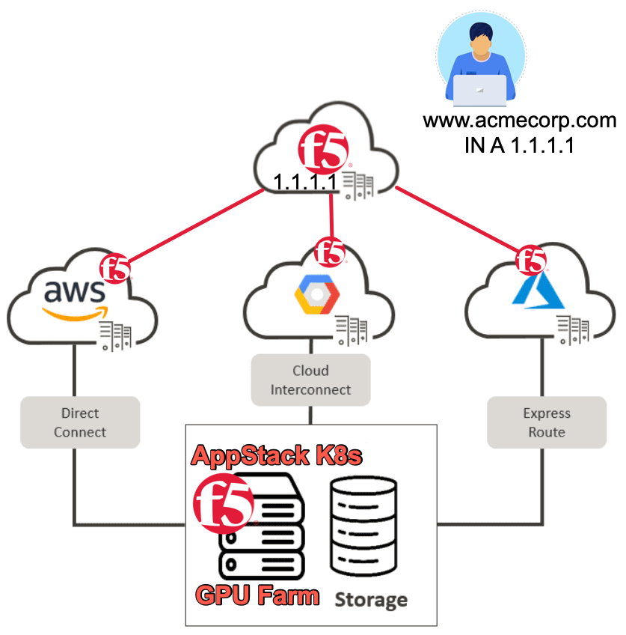
Appstack Managed Kubernetes
Notes:
An F5 Distributed Cloud instance can also be deployed as a managed kubernetes platform either as a virtual machine or onto bare metal. Appstack managed kubernetes is able to leverage high performance GPU in public cloud, or even when its deployed into hardware in remote locations or retail space. Computationally intensive containerized workloads running in Appstack managed kubernetes can leverage GPU's. One example is that many organizations are deploying privately available AI service which are running open source LLM's.

Slide 15
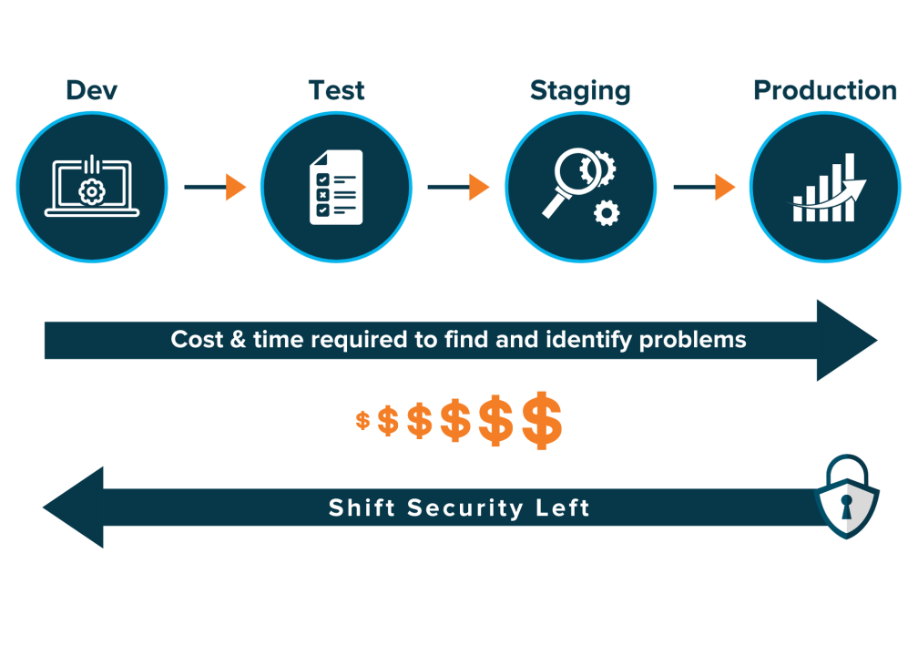
Shift Left Security
Notes:
Shift Left is a practice intended to find and prevent defects early in the software delivery process. The idea is to improve quality by moving tasks to the left as early in the lifecycle as possible. Shift Left testing means testing earlier in the software development process, and this lends itself to adopting DevOps practices.

Slide 16
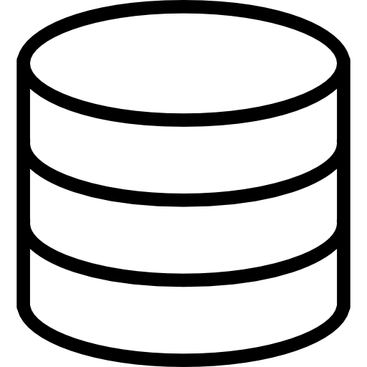



GitOps - SDLC
Building Security Into Software Development Cycle
SAST CI/CD Trigger Scans
DAST CI/CD Trigger Scans
Software
Development
Code Repository
Release!
Code Repository
Release!
CI/CD Tools
Check-in
Check-in
CI/CD Tools
Check-in
Check-in
-Build
-Test
- Deploy
-Build
-Test
- Deploy
Dev 1
Dev 2
Dev 3
Dev 4
Success
Failed
Fix

Slide 17
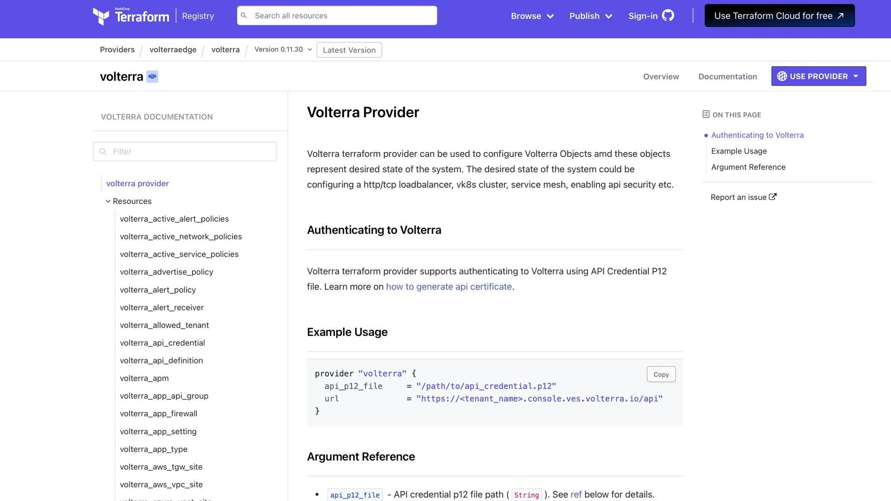
Terraform Provider
Notes:
The whole F5 Distributed Cloud platform can be automated using the REST API, either directly using the RBAC enforced token authentication. Tokens can be incorporated into existing CICD pipelines. There are official F5 Github repositories with terraform examples for creating infrastructure as code.

Slide 19
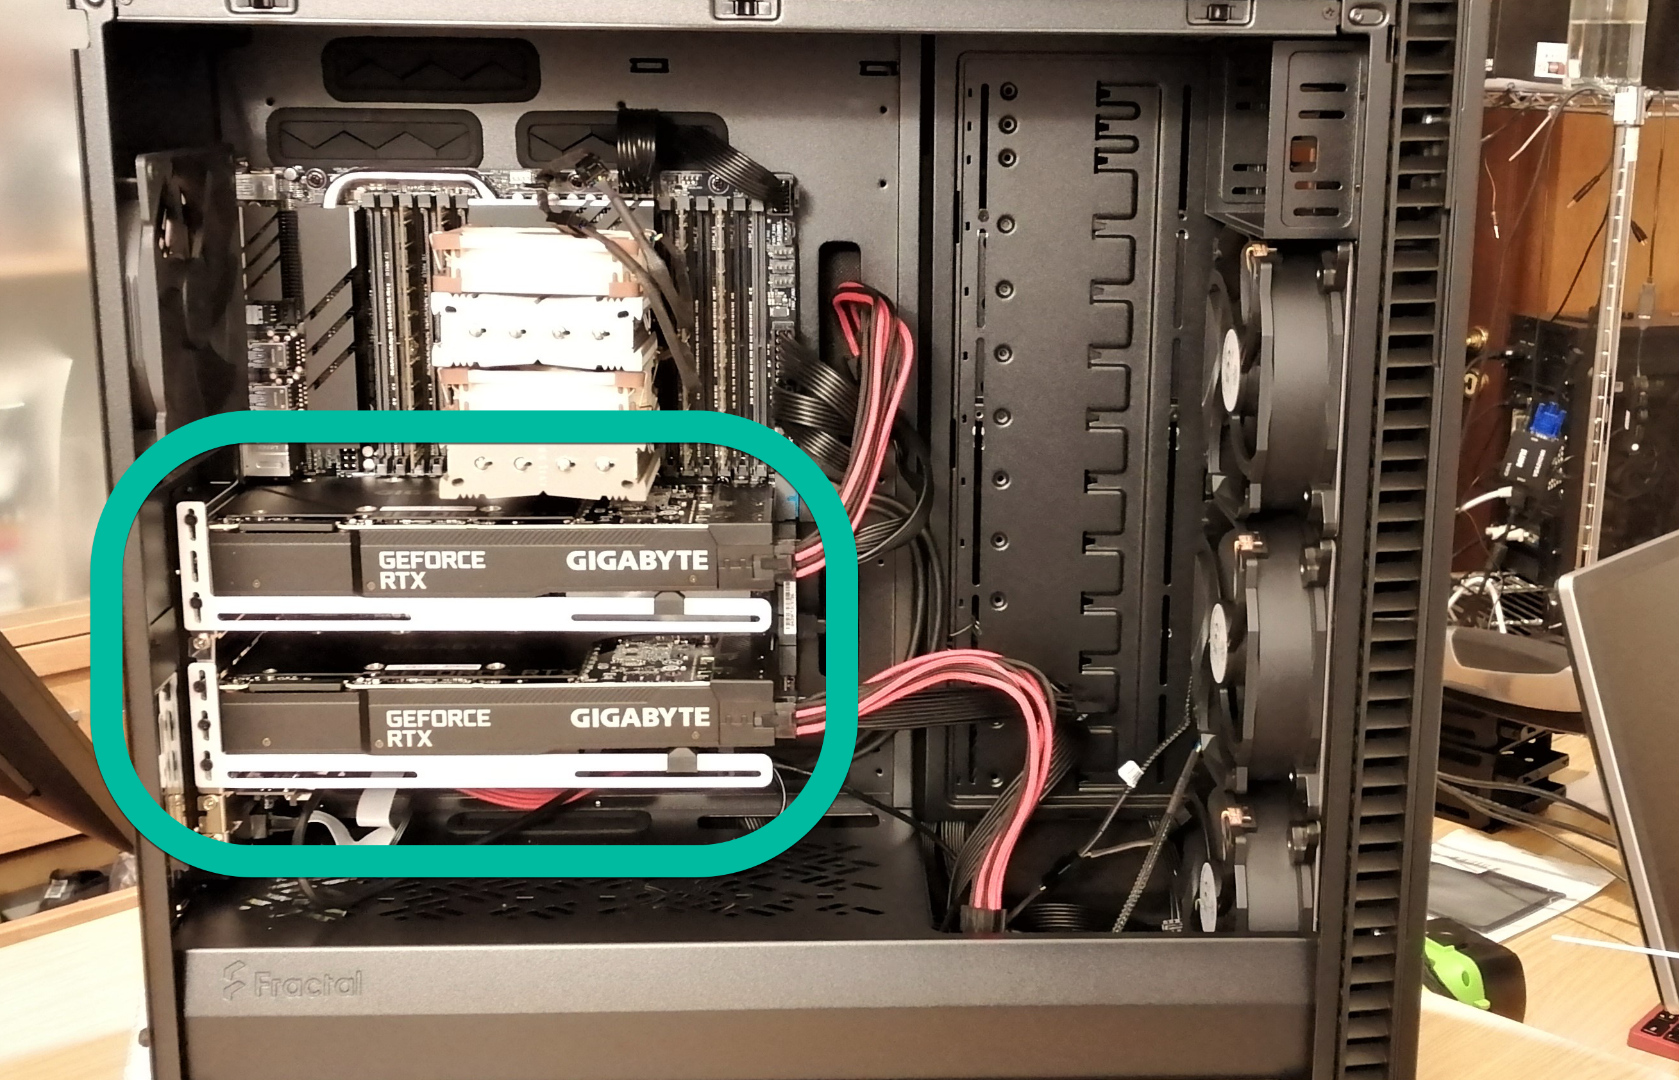
Notes:
The weapon of choice here is the RTX 3090 which is the previous generation to the current 4090.
I found two 3090’s used for 500$ each, and its also capable of using NVLINK to cluster them which then appears as a single GPU with 48GB of RAM.
This will allow you to load the much larger models, which are much better.

